Slide 1
Smart Electrical Appliance Control
DLD Project
Group Members:
Amaan Majeed
M. Hashim Khurshid
M. Usaid Afzal

Slide 2
Smart Switches
The Project is centered towards the people who are disabled at the age where they are unable to go to the switch outlet manually and turn light or fan on. This product eliminates the need to physically approach an outlet. The device is programmed in a way which helps the user to turn the appliance on by just saying the command (With the help of Amazon Alexa) or toggling it through the web browser which is easily accessible through a smart phone/laptop/ Tablet.

Slide 3
Components
Node Mcu
Relay Board
Electrical Switches
Micro USB cable
Jumper Wires
Power Supply
Amazon Alexa (Optional)

Slide 4
Node MCU
Node mcu is an Arduino based micro controller which has Wi-Fi chip esp8266 attached to it giving us access to GPIO pins to interact with the chip itself.

Slide 5
Relay Board
Relay board is a series of relays connected together. Relay is a magnet-based switch which is usually operated at 5v. They receive commands in signals to operate the switches and the voltage provided to them completes the circuit according to the signal, hence turning the circuit on/off.

Slide 6
Uses
Turn electrical appliances on/off remotely
No need to physically get up to turn your lights off
Remotely access it from anywhere in the world

Slide 7
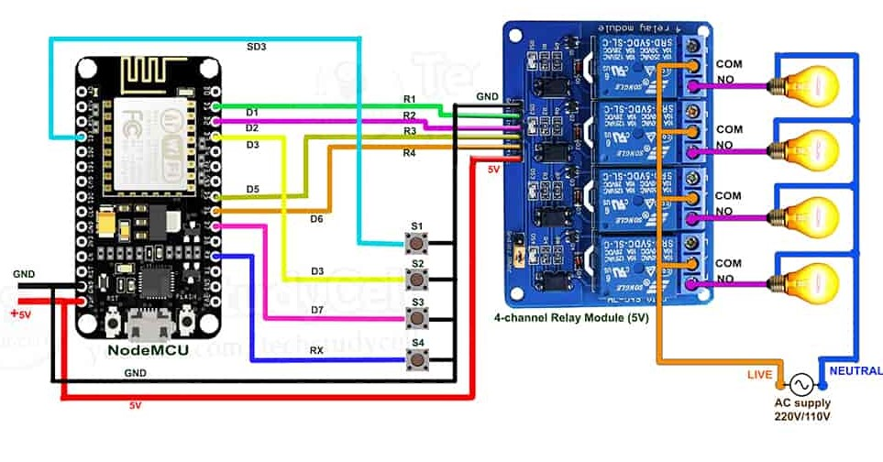
Diagram

Slide 8
Procedure
Relay 1: D1
Relay 2: D2
Relay 3: D5
Relay 4: D6
Switch 1: SD3
Switch 2: D3
Switch 3: D7
Switch 4: RX

Slide 9
Functionality
Turn on appliances remotely through:
Phone
Tablet (Any device with a browser)
Laptop
Amazon Alexa
Phone Cellular
Manually (Through Switches)

Slide 10
Thanks
Hope you liked our project
If you have any questions now would be the perfect tume to go ahead

